Slide 1




City Corporation
Management System

Slide 2

Overview
The system -manages:
Citizens and their information
Employees and the departments they work in Projects, Services, and Complaints
Relationships between all these entities

Slide 3

ER Diagram

Slide 4

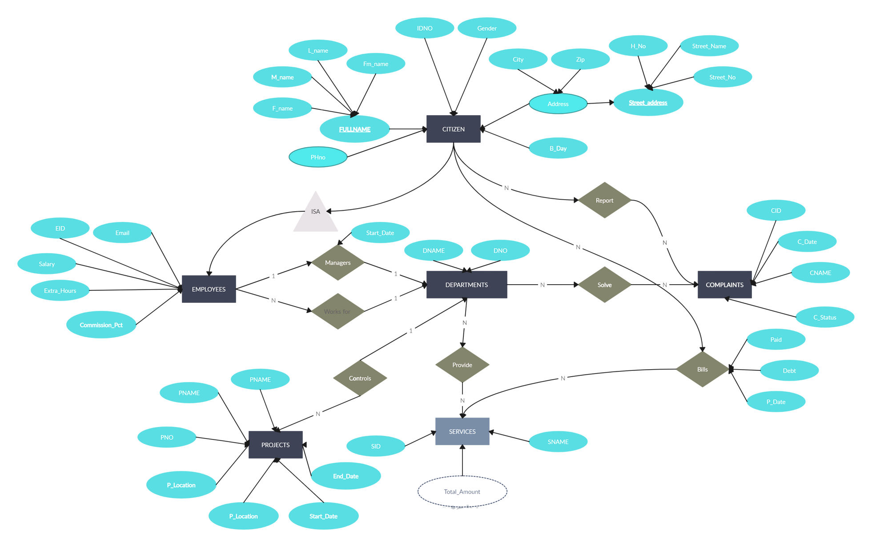

work

Slide 5


1. CITIZEN
IDNO (Primary Key)
Gender
B_Day
PNo (Phone Number)
Address
City
Zip

Slide 6
2. FULLNAME
IDNO (Primary Key, Foreign Key → CITIZEN)
F_name
M_name
L_name
Fin_name

Slide 7
3. STREET_ADDRESS
Address (Primary Key, Foreign Key → CITIZEN)
H_No
Street_Name
Street_No

Slide 8
4. EMPLOYEES
EID (Primary Key)
Email
Salary
Extra_Hours
Commission_Pct
Start_Date
IDNO (Foreign Key → CITIZEN)
DNO (Foreign Key → DEPARTMENTS)

Slide 9
5. DEPARTMENTS
DNO (Primary Key)
DNAME
DNAManager (References an EMPLOYEE as manager)

Slide 10
6. PROJECTS
PNO (Primary Key)
PNAME
P_Location
Start_Date
End_Date

Slide 11
7. SERVICES
SID (Primary Key)
SNAME
Total_Amount

Slide 12
8. COMPLAINTS
CID (Primary Key)
C_Date
CNAME
C_Status
Paid
Debt
P_Date
IDNO (Foreign Key → CITIZEN)

Slide 13
Key Relationships
EMPLOYEES:-
Works for → One department (DEPARTMENTS)
Managed by → A single EMPLOYEE manages one department

Slide 14
Key Relationships
DEPARTMENTS:-
Controls → Multiple PROJECTS
Provides → Multiple SERVICES
Solves → Multiple COMPLAINTS

Slide 15
Key Relationships
PROJECTS
Controlled by → One DEPARTMENT
CITIZEN
Reports → Multiple COMPLAINTS
COMPLAINTS
Linked to → SERVICES through BILLS (with Paid, Debt, P_Date)

Slide 16
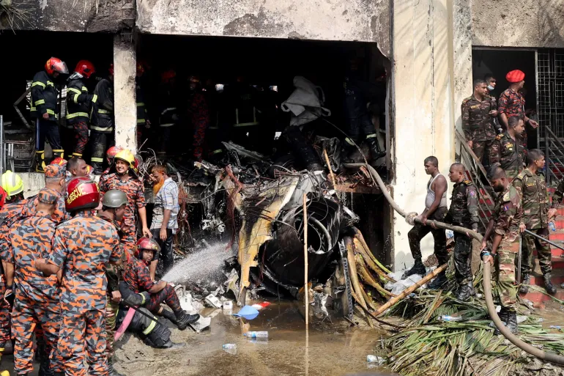
WE MOURN
The tragic air crash at the Milestone School & College premises in Dhaka.

